Slide 1
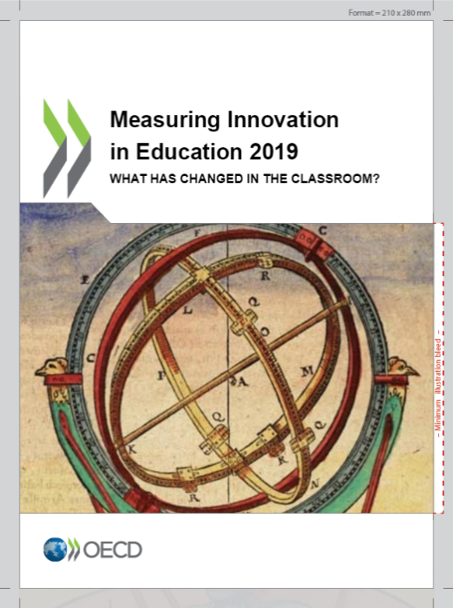
Some additional findings on Singapore
24 more primary students in 100 had their teachers visiting another classroom to learn more about teaching, reaching a 25% coverage;
30 less primary students in 100 visited a library other than their classroom library, reaching a 50% coverage;
27 more secondary students in 100 had teachers frequently using memorisation of rules, procedures and facts as a pedagogical technique in maths, reaching a 43% coverage ;
18 more secondary students in 100 had their math teachers visiting another classroom to learn more about teaching, reaching a 20% coverage;
More information is available in the report:
Singapore
Measuring Innovation in Education 2019:
What has changed in the classroom?
How much have the education systems across the world innovated in the last decade? Have pedagogical practices changed significantly? Has the use of technology spread? Have assessments become more important in pedagogical practices? Are students given more agency in their learning? Are they still asked to memorise facts and procedures?
Purpose of the report
Measuring innovation in education and understanding how it works is essential to improve the quality of the education sector. We need to examine whether, and how, practices are changing within classrooms and educational organisations and how students use learning resources. We should know much more about how teachers change their professional development practices, how schools change their ways to relate to parents, and, more generally, to what extent change and innovation are linked to better educational outcomes. This would help policy makers to better target interventions and resources, and get quick feedback on whether reforms do change educational practices as expected. This would also enable us to better understand the role of innovation in education.
This new edition of Measuring Innovation in Education examines what has (or has not) changed for students over the past decade in OECD education systems. It reviews no fewer than 150 educational practices. The report casts light on systemic innovation in primary and secondary education, with a focus on pedagogical innovation. Has the use of technology spread? Have assessments become more important in pedagogical practices? Are students given more agency in their learning? Are they still asked to memorise facts and procedures? Do teachers increasingly engage students in peer learning activities? These are some of the questions this book seeks to answer. This report also presents some preliminary findings about the links between innovation and educational performance.
This book will offer precious insights to policy makers, the education community and all those who seek to understand how educational practices are evolving.
Key findings for Singapore
Singapore witnessed one of most precipitous falls in the availability of computers in schools, driven mostly by a decrease in students’ access to computers during maths, science and reading lessons in the 4th grade.
In the classroom, pedagogical activities based on active learning have seen an outstanding increase in science lessons, mainly in primary, where it has been one of the highest among the countries surveyed.
Key findings for OECD education systems
On average, there has been a moderate level of innovation in OECD education systems, perhaps more than one would often say, but probably less than what would be needed to really improve education systems
Many education systems have experienced high levels of technology-related innovation, with a slight decrease in access to computers and a significant increase of the use of ICT in pedagogical practices. Furthermore, on average, access to laptops increased by 17 % points between 2009 and 2015.
In many countries, peer learning has spread as a teacher professional development practice- an increase of 40 % points for the OECD on average.
While many policy debates have focused on “21st century skills” in the past decade, rote learning practices have spread to a similar extent as active learning practices, an increase of 28 and 26 % points respectively.
While in some practices there have been similar patterns across education systems, in most of them there does not seem to be an international convergence on pedagogical and educational practices. Innovation is however not a panacea and some changes are not always accompanied by improvements in outcomes.
Methodology
The book examines the diffusion or contraction of about 150 educational practices from 2006 to 2016 by analysing data from three international education datasets – Trends in International Mathematics and Science Study (TIMSS), Progress in International Reading Literacy Study (PIRLS), and the Programme on International Student Assessment (PISA). Beyond identifying the areas in which each education system has demonstrated emerging or changing organisational and pedagogic practices over a specific period, the book synthesises the education systems’ intensity of innovation by computing composite indices for countries for which enough information is available. Based on effects sizes (multiplied by 100), the indices propose a continuum, but innovation intensity can be considered as relatively small when below 20, moderate between 20 and 40, and large above 40. More details on the methodology can be found in the report.
Questions and queries may be directed to:
Stéphan Vincent-Lancrin
Senior Analyst and Project Leader
Stephan.VINCENT-LANCRIN@oecd.org
Visit https://tinyurl.com/MIE2019 for more information on the report

Slide 2
