Slide 1
SANAD Fund for MSME
Investing in Employment and Entrepreneurship

Slide 2
SANAD‘s Target Region and Strategic Focus
01

Slide 3
Mission and Objectives
SANAD’s mission is to foster employment creation, especially among the youth, and economic development in the Middle East and North Africa ("MENA") region through the sustainable provision of finance to micro, small and medium-sized enterprises ("MSME") via qualified and eligible partner institutions.
The purpose of the Fund is driven by three main targets:
Maintain and create employment, especially for the youth – primarily through support to small and medium enterprises
Reduce poverty – by facilitating self-employment, primarily through microfinance
Build inclusive financial systems – by cooperating with banks, microfinance institutions and other institutions to facilitate access to financial services

Slide 4
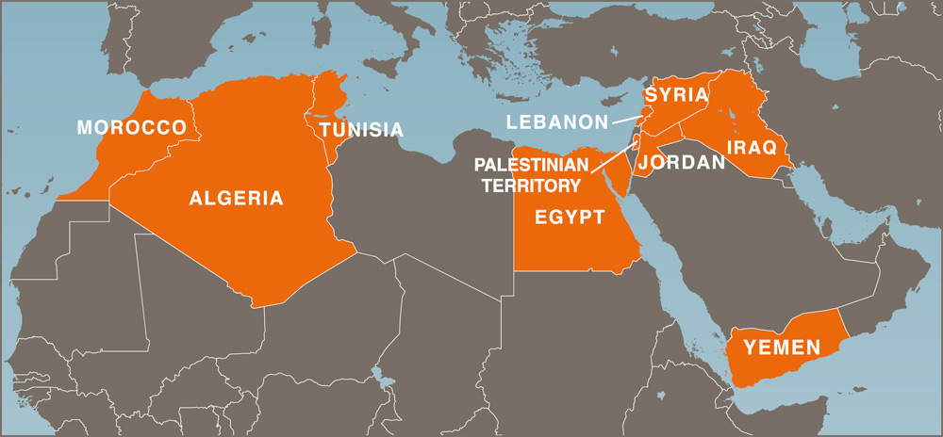
The Fund‘s Target Region
Local Presence – An agile Fund close to its clients
Local activities are coordinated through Finance in Motion’s representative office in Cairo, Egypt.

Slide 5
Strategic Focus of the Fund: Reaching the “Missing Middle”
Too big for MFIs, too small for banks
MSMEs of key importance for economic growth and employment creation
Micro enterprises: served by MFIs
Medium enterprises: served by banks
Small and very small enterprises: facing difficulties in accessing loan products – Too big for MFIs, too small for banks
MSME finance: huge source of growth potential for the financial sector
Role for SANAD
Targeted financing solutions to allow banks and MFIs to work with the ‘missing middle’
Hands-on technical assistance (knowledge, tools, training) to support banks and MFIs in increasing its outreach to the ‘missing middle’

Slide 6
SANAD‘s Working Mechanism
02

Slide 7
Working Mechanism
Straightforward channels and a lean structure
Donors / Investors
International
Financial Institutions
Donor Agencies
Private Investors
Financial Instruments
Medium to long-term senior loans
Local currency loans
Subordinated loans
Equity and quasi equity
Guarantees
Capacity Building
Financial Instruments
Partner Institutions
Commercial Banks
Microfinance
Institutions
Other Institutions
Financial Services
Micro, Small and Medium Enterprises
Notes:
1) Public-Private Partnership / strong investor base:
Sustainability -> ability to commit long-term to the region
Nearly unlimited funding for the support of small business available
2) Promoting domestic currency lending
Briefly explain why this is critical (e.g. protecting end-
beneficiaries from devaluation )
3) Cooperation with partner institutions that support the Fund’s mission and responsible finance practices
Briefly explain what EFSE understands by “responsible finance” (disclosing effective interest rates etc.) – use an example!
4) TA support -> EFSE is more than just a fund
Crisis support
Use an example to illustrate what the DF does
5) No financing of consumer loans
Briefly explain why
EFSE only provides funds for investment loans that
generate (additional) value
In Macedonia: 36% of EFSE loans go to the production sector (> than the percentage (of 26%) for the overall region

Slide 8
SANAD‘s Financial Instruments: Not just funding, financial solutions
Our goal: provide financial institutions on the ground with instruments adapted to their specific refinancing needs
Short, medium and long term senior debt
Subordinated loans, including mezzanine loans
Term deposits
Certificates of deposit
Term enhancement instruments, e.g. standby facilities
Co-investments
Standby letters of credit
Guarantees
Equity participations

Slide 9
SANAD‘s Partner Institutions (PIs): An inclusive approach for reaching the MSME sector
Our commitment: to be open to the broadest spectrum of financial actors in the MENA Region, including:
Microfinance Institutions (MFIs)
Commercial banks
Leasing and factoring companies
Financial service providers
Other financial institutions

Slide 10
Eligibility Criteria for SANAD‘s Partner Institutions
MSME target group orientation
Strategic orientation towards MSMEs, including approach, policies and procedures
Minimum thresholds in outreach and regional diversification
Financial strength
Minimum standards in key financial ratios
Qualified management and sound internal systems and processes, e.g. risk management policies, MIS and internal controls
Environmental, Social, Governance
Promotion of good governance, integrity and transparency standards
Adoption of international and local social and environmental guidelines
Adherence to Responsible Finance principles

Slide 11
Institutional and Fund Structure
03

Slide 12
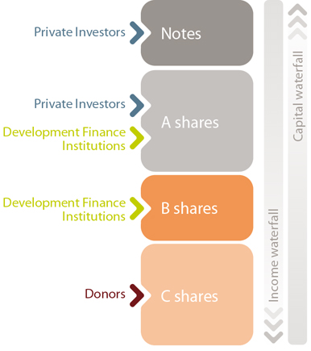
Capital Structure Sources of funds: A public-private partnership model
Debt Sub-Fund
Fund rests on a junior tranche of C shares financed mainly by donors, which bear the first net loss risk
B shares for tenors of 5 to 10 years are protected by C shares and affected only if C shares are depleted
A shares for tenors of 3 to 10 years only suffer potential losses if B and C shares are fully depleted
Tiered risk sharing maximizes public fund leveraging
Subordination mechanism provides strong risk protection for senior investors and enable the Fund to channel private capital to high risk countries such as in the MENA region, supporting the region’s development of capital markets and access to long-term financing.

Slide 13
Institutional Structure A solid foundation, transparent processes
The Board of Directors oversees the Fund‘s investment activities, defines its positioning and monitors the service providers
The Investment Committee supervises the activities of the Fund Managers and approves all SANAD investment decisions
The Technical Assistance Facility Committee oversees the Facility‘s activities and approves all technical assistance projects

Slide 14
SANAD‘s Technical Assistance Facility Capacity Building and Training
04

Slide 15
The SANAD Technical Assistance (TA) Facility: Hands-on support to maximize development impact
The TA Facility provides technical assistance and training to support new growth opportunities in MSME finance.
Our objective: Support our Partner Institutions in
optimizing product offerings,
tapping new customer segments,
adapting to alternative lending technologies, and
developing new initiatives.
SANAD’s principles:
tailor technical assistance to the specific needs of our clients,
institutionalize close collaboration during the project development and implementation, and
ensure transparency and flexibility.

Slide 16
The TA Facility‘s Target Areas
The SANAD TA Facility provides hands-on support focused on – but not limited to – the following target areas:
Market and feasibility studies
Strategy design and business model development
Development of MSME finance operating models
Product development
Lending methodology
Middle management organization
Delinquency and credit risk management
Financial management and asset-liability management
Institutional transformation
The TA Facility will also support financial sector development measures.

Slide 17
SANAD Fund for MSME
Funded by
Initiated by
Managed by
Funded by
Initiated by
Managed by
Funded by
Initiated by
17
17

