Slide 1
OECD Special Event on “Policy Options for Reviving Investment in the MENA Region: Protection, Promotion and Risk Mitigation” of the MENA-OECD Investment Programme
December 06 , 2011
OECD Headquarters in Paris, France
Mona Zobaa
Undersecretary / Head of Investment Policy Department
Ministry of Investment
Egypt, Cairo

Slide 2
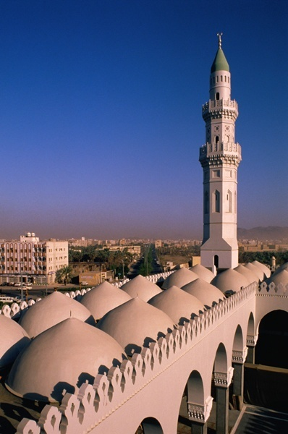
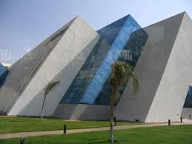
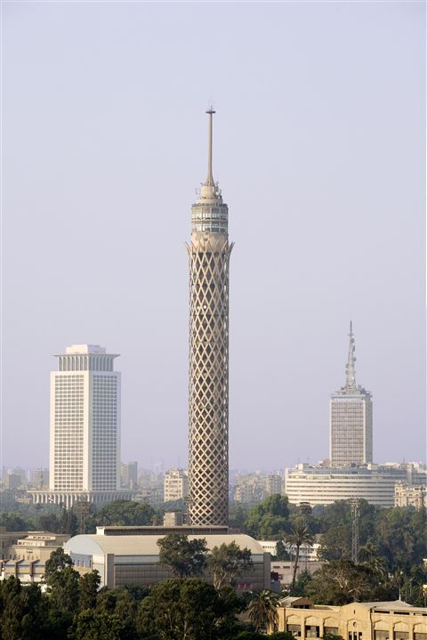
Contents
Recent Developments in the Egyptian Economy
Foreign Direct Investments in Egypt
Notes:
2
2

Slide 3
Recent Developments in the Egyptian Economy

Slide 4
Recent Developments in the Egyptian Economy
Source: MOP

Slide 5
Recent Developments in the Egyptian Economy
Source: MOP

Slide 6
Recent Developments in the Egyptian Economy
Total Investment / GDP *
EGP billion
%
-2.7%
Source: MOP

Slide 7
Recent Developments in the Egyptian Economy
Engagement of the Private Sector
Source: MOP

Slide 8
Recent Developments in the Egyptian Economy
Monthly No. of Companies establishment
Egypt completely eliminated the minimum capital requirements for limited liability companies.
Between FY 2004/05 and FY 2010/2011 the number of newly established companies stood at 43,934 ; which constitutes around 56% of all establishments created since 1970.
Source: GAFI

Slide 9
Recent Developments in the Egyptian Economy
Issued capital of established companies
2004/2005 - Oct. 2011/2012
July 2009/2010 = 1325.80 EGP Million
August 2009/2010 =1160 EGP Million
October 2009/2010= 2309 EGP Million
Source: GAFI

Slide 10
Recent Developments in the Egyptian Economy
Foreign contribution in Issued capital of established companies
2004 / 2005 – 2011 /2012
 | 2004/2005 | % | 2005/2006 | % | 2006/2007 | % | 2007/2008 | % | 2008/2009 | % | 2009/2010 | % | 2010/2011 | % | July-Sep. 2011/2012 | %
Egyptians | 14043.31 | 79% | 8033.68 | 71% | 23236.61 | 63% | 15301.32 | 66% | 11238.69 | 74% | 16785.96 | 88% | 10963.85 | 81% | 2775.45 | 79.8
Arab | 2445.5 | 14% | 1350.18 | 12% | 11921.82 | 32% | 5371.1 | 23% | 1444.43 | 9% | 1116.68 | 6% | 1391.12 | 10% | 622.69 | 17.9
Foreign | 1304.31 | 7% | 1902.23 | 17% | 1745.13 | 5% | 2454.53 | 11% | 2578.41 | 17% | 1249.58 | 7% | 1112.33 | 8% | 81.32 | 2.3
Total | 17793.12 | 100% | 11286.09 | 100% | 36903.56 | 100% | 23126.95 | 100% | 15261.53 | 100% | 19152.22 | 100% | 13467.3 | 100% | 3479.46 | 100%

Slide 11
Foreign Direct Investments in Egypt

Slide 12
Recent Investments in Egypt
Foreign direct Investment
.
.
19%
- 38.6%
80%
54%
-16.5%
-67.6%
Source: CBE

