Slide 1
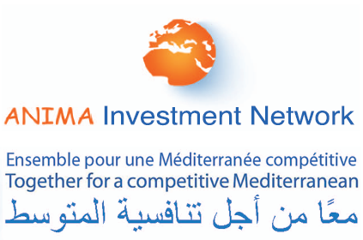
Updates on FDI trends in the MED-11 countries
MENA - OECD Investment programme
Emmanuel Noutary, General Delegate, ANIMA
Paris, 6 December 2011
www.anima.coop

Slide 2
Foreign investment in MED 2003-2010
An overall growing dynamic
A change in project pattern
  Smaller projects, more SMEs
  A switch to partnerships
Nbr of FDI projects in MED-11 (source ANIMA/MIPO)

Slide 3
FDI trends in 2011
  -34% of FDI amounts vs 2010, -26% of FDI projects
  -42% of partnership projects
FDI amounts in MED-11 countries, in M€ (source ANIMA/MIPO)

Slide 4
Origin of FDI
EU investors remain loyal to the Med countries
Gulf countries at their lowest
Shares of MED-11 FDI regions of origin (source ANIMA/MIPO)

Slide 5
Country distribution
High reductions in the countries in transition and their neighbours
Morocco and Algeria show good resilience
Turkey and Israel total 50% of 2011 FDI
Nbr of FDI projects in MED-11 (source ANIMA/MIPO)

Slide 6
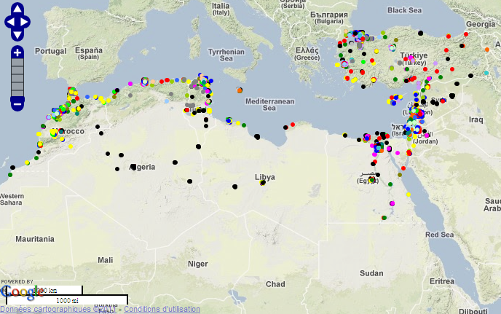
Seeds of revolutions
Highly unbalanced territorial distribution of FDI
Geolocalisation of FDI projects on www.medmaps.eu (source: ANIMA-MIPO 2003-2010)

Slide 7
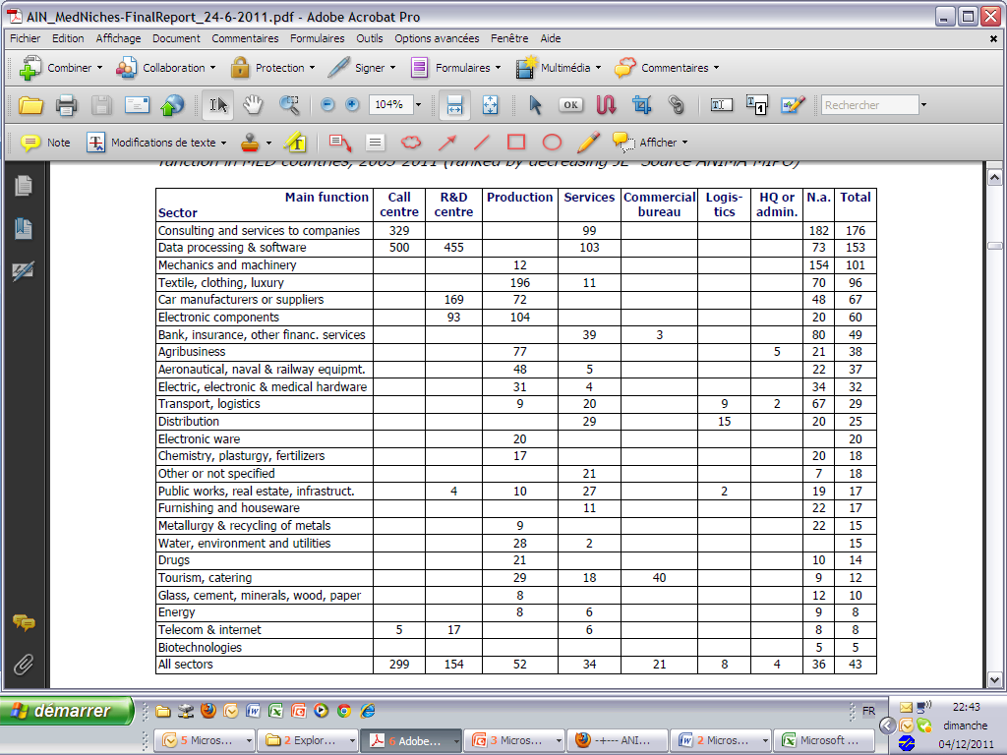
Seeds of revolutions
The economic crisis favoured growing FDI in infrastructures
  The less efficient sectors in terms of job creation
FDI distribution by sector (source: ANIMA-MIPO)
FDI job efficiency* (source: ANIMA for the World Bank)
*nbr of jobs per million € invested

Slide 8
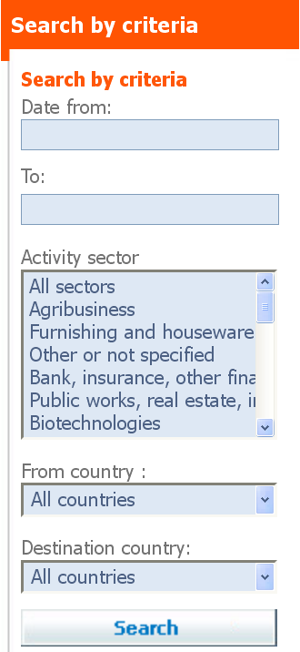
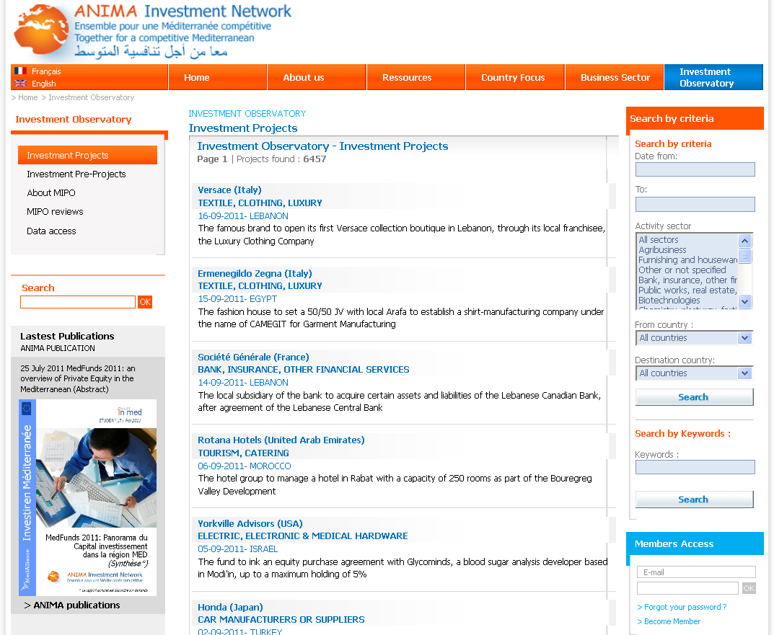
ANIMA-MIPO, the Mediterranean
Investment and Partnership Observatory
  Each project is selected according to 40 criteria (investor, target and origin country, amounts involved, jobs created, etc.)
www.anima.coop/en/mipo
Notes:
Any actor can be aware of the development of investment and partnerships between companies in the South of the Mediterranean : just visit the www.anima.coop/en/mipo website

Slide 9
Thank you for your attention
Emmanuel NOUTARY
emmanuel.noutary@anima.coop
ANIMA Investment Network
11b rue Saint Ferréol
13001 Marseille – FR
T. +33(0) 4 9611 6760
www.anima.coop

