Slide 1
The Arab Spring - the Economic Causes Underlying the Crisis
Ania Thiemann,
Senior Economist,
MENA-OECD Investment Programme

Slide 2
Presentation to the Confederation of Danish Industry
The Arab Spring: economic and structural challenges
Middle East Day, Copenhagen, 7 December 2011
Ania Thiemann, Senior Economist, MENA-OECD Investment Programme

Slide 3
Presentation outline
Macro-economic outlook
Structural challenges
The way forward

Slide 4
The macro-economic near-term outlook is bleak

Slide 5
MENA 2010 recovery remained behind other emerging markets
GDP growth, percentage change, constant prices
Source: IMF

Slide 6
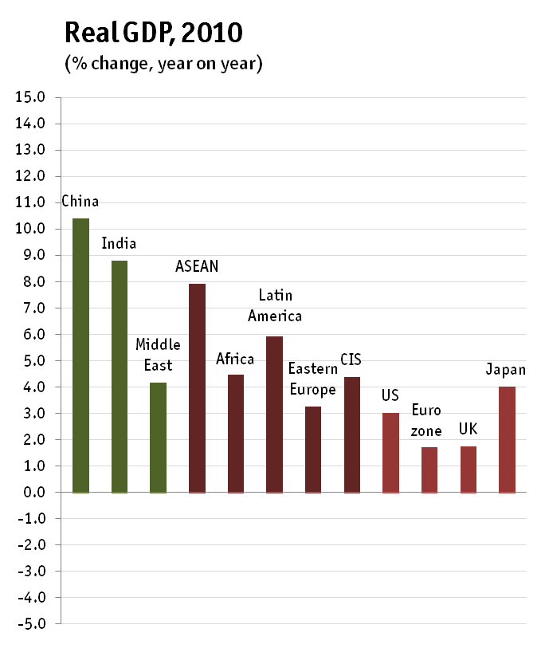
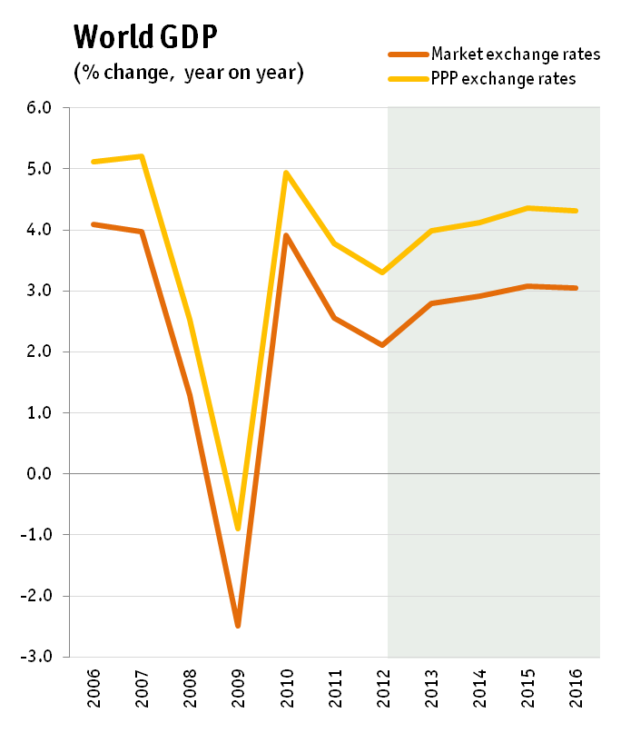
2010 recovery has been stifled in 2011 owing to sovereign debt crisis and slowing global trade
Source: Economist Intelligence Unit

Slide 7
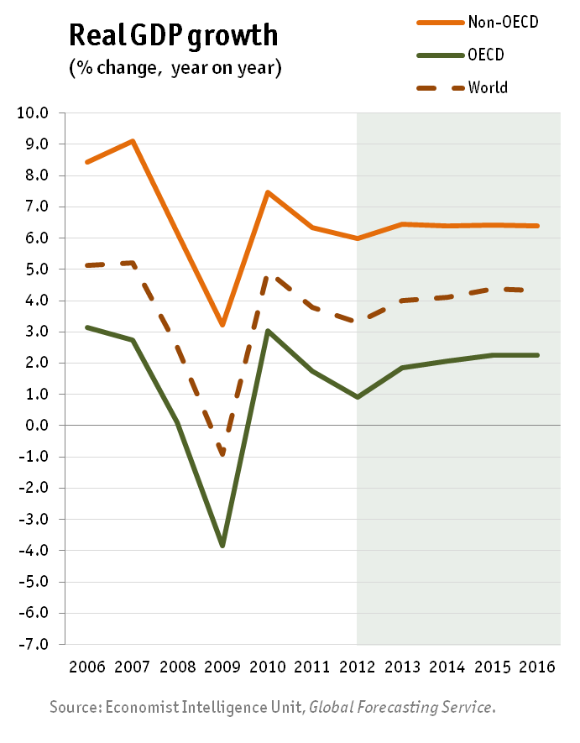
Emerging markets will be affected by slowing demand in OECD
The Brazilian and Israeli central banks have responded to the worsening global outlook by cutting policy rates.
With inflationary pressures now abating, other EM central banks may cut rates or at least postpone monetary tightening.
EMs lost momentum over the course of 2011 as developed markets hit the buffers. China is showing stresses in the housing market.
For 2012 growth patterns are likely to reflect sluggish demand in OECD.
EMs are still likely to post stronger growth than OECD countries in 2012.

Slide 8
Civil unrest and political upheaval are taking its toll on economic performance
Egypt, Yemen, Syria, Tunisia and Libya have all experienced negative growth in 2011.
In Egypt, FDI fell from USD6.8bn in fiscal year 2009/10, to USD2.2bn in 2010/11; the lowest level since 2003/04, prior to economic reform programme
FDI into Egypt was negative in Q3 (Jan-Mar) and registered just USD100M in Q4 (Apr-Jun).
In Tunisia, FDI was down by 40% in H1 2011.
In Libya, it is estimated that GDP will have contracted by up to 30-50% in 2011.

Slide 9
GDP growth estimates for 2011 have been reassessed after onset of “Arab Spring”
Many forecasts for GDP growth have been revised down for 2011.
Tunisia and Egypt will stagnate, with real GDP growth rates forecast at 0% and 1%.
Some oil exporters, less affected by unrest, such as Kuwait or Saudi Arabia, are expected to grow at a higher rate.
This is a consequence of higher oil prices and large spending increases announced in order to placate social discontent.
Source: IMF (2010, 2011)

Slide 10
FDI levels in MENA have not recovered since the international financial crisis
FDI inflows to selected regions (1991-2010)
FDI inflows to selected regions (1991-2010)
Source: UNCTAD.

Slide 11
Tourism, an important sector in many MENA economies, has been severely affected
The sector is vulnerable to risk perceptions and has been affected strongly in 2011.
Egypt | According to Egypt’s tourism minister, revenues from tourism in March were 60% below 2010 levels.
Tunisia | Tunisian tourism receipts to end-February were US$130m, almost 40% down year on year. According to the Minister for Tourism, speaking in June, numbers were expected to be halved compared with 2011 (3.5m tourists, 1.8m Dinars).
Bahrain | In Bahrain, hotel occupancy rates plummeted to 5%-10%. In addition, the Formula One Grand Prix, which contributed US$600m or 2.9% of GDP to Bahrain’s economy in 2008, was cancelled.

Slide 12
Government budgets are coming under strain, increasing vulnerabilities
Most MENA oil importers are facing widening budget deficits in 2011 as a result of:
Immediate costs of unrest (economic disruptions, loss of tax revenues, security expenses, compensations)
Increased public spending (tax cuts, pay raises, creation of government jobs)
High food and energy prices (subsidies)
Most MENA oil exporters (except for Yemen and Syria) are expected to generate budget surpluses in 2011 based on conservative estimations of annual average oil prices.
Large spending increases announced by governments will add strain to public finances in coming years:
Infrastructure projects, new government jobs, pay increases, cash benefits to populations.

Slide 13
Structural challenges may jeopardise a return to normal in the medium term

Slide 14
A tale of three regions
Resource poor countries
Djibouti, Egypt, Jordan, Lebanon, Mauritania, Morocco, Tunisia and the Palestinian Territories
Resource rich, labour abundant countries (LA)
Algeria, Iraq, Syria and Yemen
Resource rich, labour importing countries (LI)
Countries in Gulf Co-operation Council (GCC) (Bahrain, Kuwait, Oman, Qatar, Saudi Arabia and the UAE) and Libya
Group | GDP billion US$ (PPP) | % MENA GDP | Population in millions | % MENA population | GDP per capita US$ (PPP)
Resource poor | 854.1 | 31.8 | 144.0 | 48.1 | 6 701
L. A. | 536.2 | 19.9 | 111.1 | 37.1 | 5 425
L. I. | 1 298 | 48.3 | 44.2 | 14.8 | 34 204
MENA | 2 689 | 100 | 299.3 | 100 | 19 826

Slide 15
Resource rich, labour importing countries have small populations and high income levels
GDP (2010) and total population (2009)
Colour coding: Resource poor; resource rich, labour abundant; resource rich, labour importing
The size of the bubble indicates the size of the population
Sources: IMF and World Bank

Slide 16
Resource poor economies are more diversified but less competitive
Manufacturing and services value added in resource poor countries is higher than in resource rich countries.
But they register lower levels of competitiveness.
The overall MENA region scores particularly low in terms of innovation.
Source: WEF

Slide 17
Resource poor countries account for a fraction of FDI inflows to the region
In absolute (USD) terms, this group of countries receives only 22% of FDI, compared to 70% for resource rich, labour importing countries.

Slide 18
Oil exporters continue to absorb the lion’s share of FDI inflows in the region
FDI inflows and GDP growth in the MENA region

Slide 19
High unemployment is a pervasive challenge that affects specific sectors of the population
Unemployment among youth, women, and the educated, 2009 or most recent year for which data are available
Source: World Bank

Slide 20
Female labour participation rate is extremely low in the MENA region
Source: World Bank.

Slide 21
Entrepreneurship in the MENA region is far below international levels
New firm entry per 100 working age population

Slide 22
There is a need to fight widespread corruption
Corruption Perceptions Index, 2010 (low corruption = 10)

Slide 23
The way forward – a few suggestions for policy reform

Slide 24
Key findings from MENA-OECD Investment Programme assessment
The “Arab Spring” has disclosed severe structural regional challenges, including low competitiveness, weak business climate, lack of job opportunities.
Growth is faltering in many MENA countries because of decreases in tourism and investment levels, political and economic uncertainty, increasing commodity prices, more difficult access to finance, etc.
High youth unemployment and unrealistic expectations on speed of transition process could aggravate the situation.
The impact on the poor is potentially acute, mostly because of food and fuel price increases but also because of lowered ST economic prospects.
Domestic and foreign investment is declining because of uncertainty. Investment deals are being cancelled, postponed or relocated to perceived safer destinations.
The financial sector is being disrupted given its high sensitivity to instability.
Fiscal deficits are widening given the increasing public spending, rising commodity prices and reduced economic growth.

Slide 25
Suggested reform measures
Employment generation programmes (public works, infrastructure investments, SME support, micro finance)
Supporting the poor (direct support and pro-poor growth)
Improving governance and business climates
Promoting regional integration for market extension and diversification
Support local economic development and job creation
Policy support and advocacy to stimulate macro, fiscal and financial stability

Slide 26
THANK YOU FOR YOUR ATTENTION
Ania Thiemann
Senior Economist, MENA-OECD Investment Programme
Ania.Thiemann@oecd.org

Slide 27
The Middle East - Outlook for Business
Angus Hindley,
Research Director,
MEED (Middle East Economic Digest)

Slide 28
ARAB-EU business network Eske Vinther-Jensen Deputy Director, DIBD

Slide 29
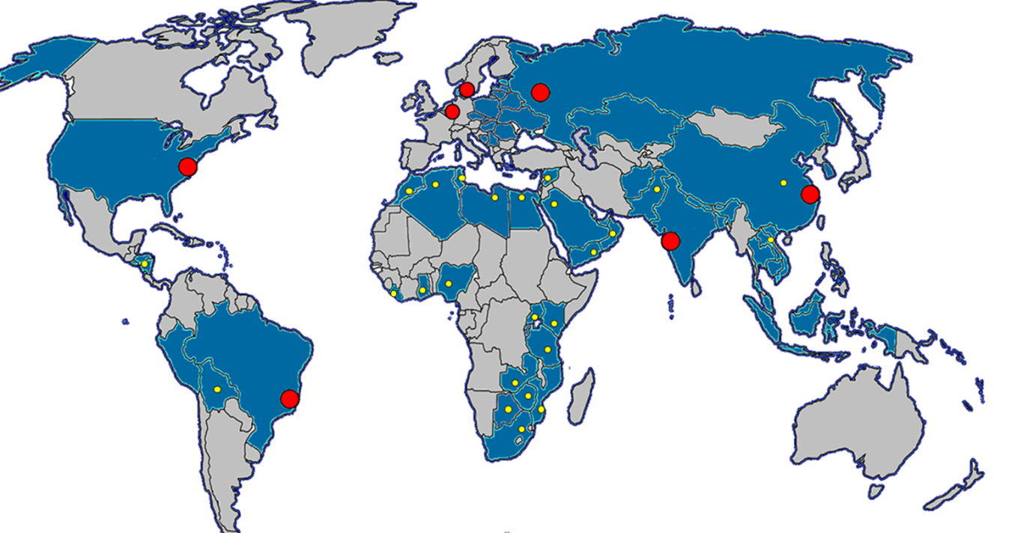
DI assists and represents members worldwide
DI offices Projects DI-cooperation with sister organisations
Notes:
DI give high priority to regional and international issues – this is simply something we need to do because our members increasingly have international interests.
It becomes clear when looking at the DI membership base. Since 1980, Danish trade with foreign countries have doubled. And since 1990s Danish investments abroad have tripled. 2/3 of the products of the processing industry is exported. And decisions about chasing new markets, outsourcing and cooperation with foreign companies is a day of everyday life in a typical Danish company. Today, DI member companies represents approx. 500.000 jobs in Denmark and another 500.000 abroad.
This is why DI needs to have an international focus and be a global actor. Both in terms of servicing and assisting members who already have international activities or who want to explore the opportunities abroad; and in terms of ensuring that their interests are represented not only in Denmark but also at a regional and global level.
DI is active at the national, regional and global level. We have foreign offices and we are represented in all the important international business networks – all in an effort to service and represent our increasingly international members properly.

Slide 30
ARAB-EU business network
Forum des Chefs des Enterprises, Algeria
Bahrain Chamber of Commerce and Industry,
Federation of Egyptian Industries,
Jordan Chamber of Industry,
Kuwait Chamber of Commerce,
Association of Lebanese Industrialists,
Libyan Businessmen Council,
Confédération Générale des Entreprises du Maroc,
Oman Chambers of Commerce and Industry,
Council of Saudi Chambers,
Damascus Chamber of Industry,
Union Tunésienne de l’Industrie, du Commerce et de l’Artisanat,
UAE Chamber of Commerce and Industry,
Qatar Chamber of Commerce and Industry
Notes:
The network covers 14 of the leading business organisations in the MENA region.
The purpose of the Network is to create a platform from which business associations can discuss the challenges for businesses and identify shared solutions and policy recommendations. A specific emphasis is on improving access the intra regional trade flows and the access to the EU market and vice versa. The Network will thus contribute to creating a more enabling environment for the private sector and seek to break down technical barriers to trade.
In the first year of the network, 40 recommendations have been developed to ease border control issues, facilitate harmonization of standards, improve export know how and better sanitary and phytosanitary standards. All recommendations are commonly agreed and sends a strong signal to the policymakers in the MENA region and the EU that a united private sector can join voices to improve the business environment and the growth opportunities for society in general.

Slide 31
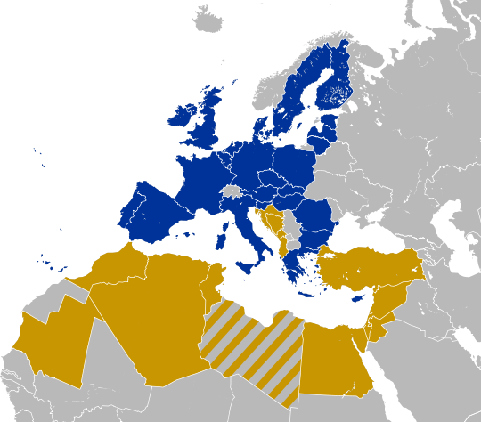
The potential…
Full member of GAFTA and member of the Arab League
Candidate member of GAFTA and member of the Arab League
EU-MENA TRADE AREA (450+300 million potential consumers)
Notes:
The potential is huge. We are neighbors with comparative advantages and existing linkages
But we need to build the knowledge and the relations between our regions, markets and enterprises to reap the benefits as well as break down any mal perceptions of the realities on the ground and to push for political reforms to secure that trade can occur more freely.
The ARAB-EU network is part of that puzzle in the medium to long run, but in the short run I believe the network is important by the fact that we are all engaged and willing to meet. In times of political and economic crisis – and looking at the global challenges - regional and international alliances, network and knowledge on new and foreign markets are of growing importance.

Slide 32
Own homepage: www.AE-network.com
Notes:
If you need more information on the network you can find it here as well as all the contact details of the participating organisations as well as you have the opportunity to meet them for a networking session afterwards.

Slide 33
Q & A

Slide 34
Coffee and Networking

