Slide 1



2017 OECD ECONOMIC SURVEY OF NEW ZEALAND
Boosting productivity and adapting to the changing labour market
www.oecd.org/eco/surveys/economic-survey-new-zealand.htm
OECD Economics
OECD

Slide 2
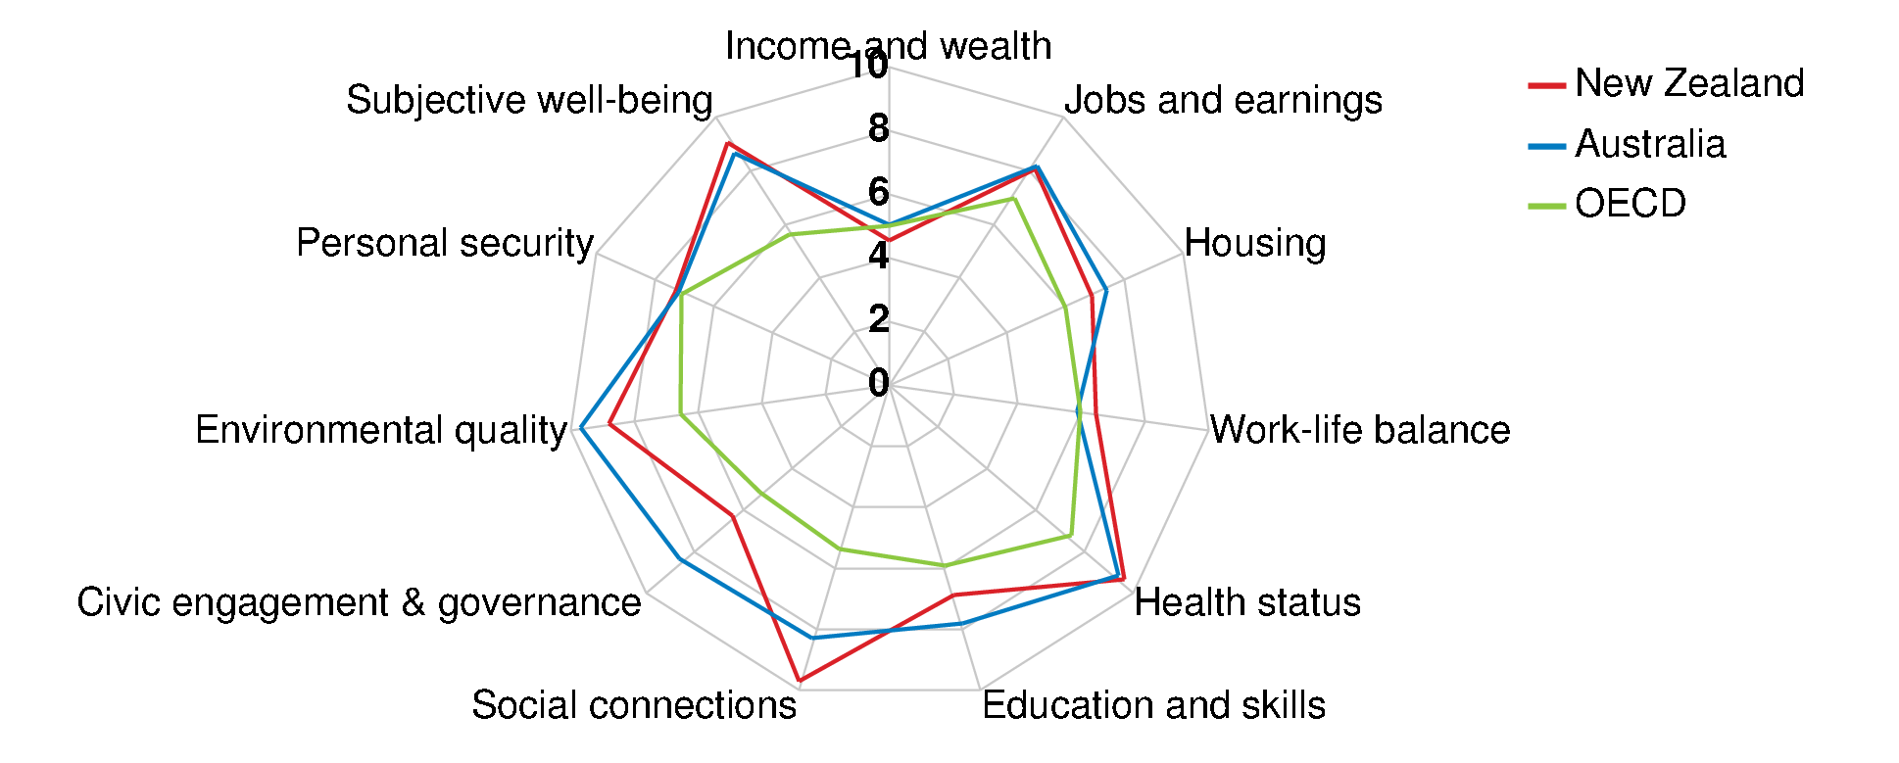
Well-being is high
Source: OECD (2016), OECD Better Life Index, www.oecdbetterlifeindex.org.

Slide 3
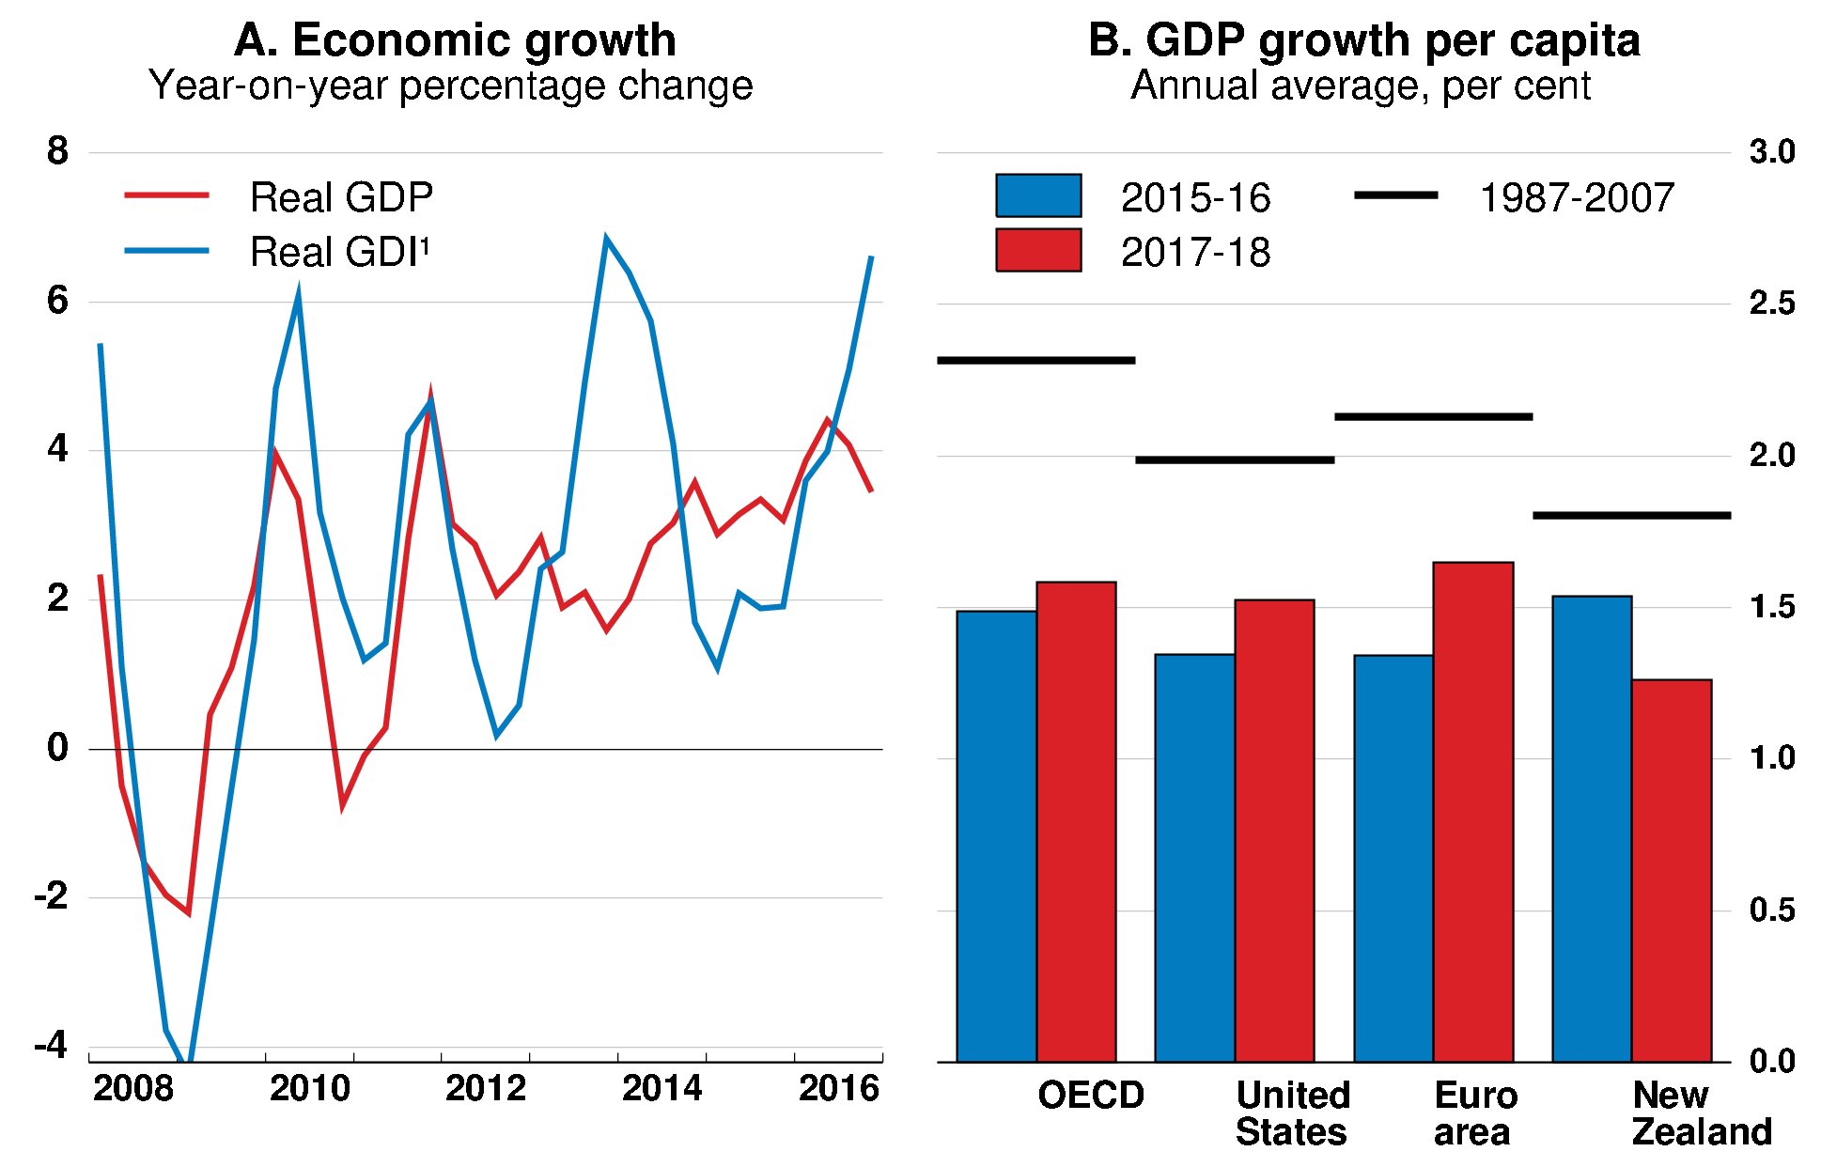
Economic growth is strong but less so in per capita terms
1. Real GDI equals real GDP adjusted for changes in the terms of trade.
Source: OECD June 2017 Economic Outlook database; OECD Income Distribution database.

Slide 4
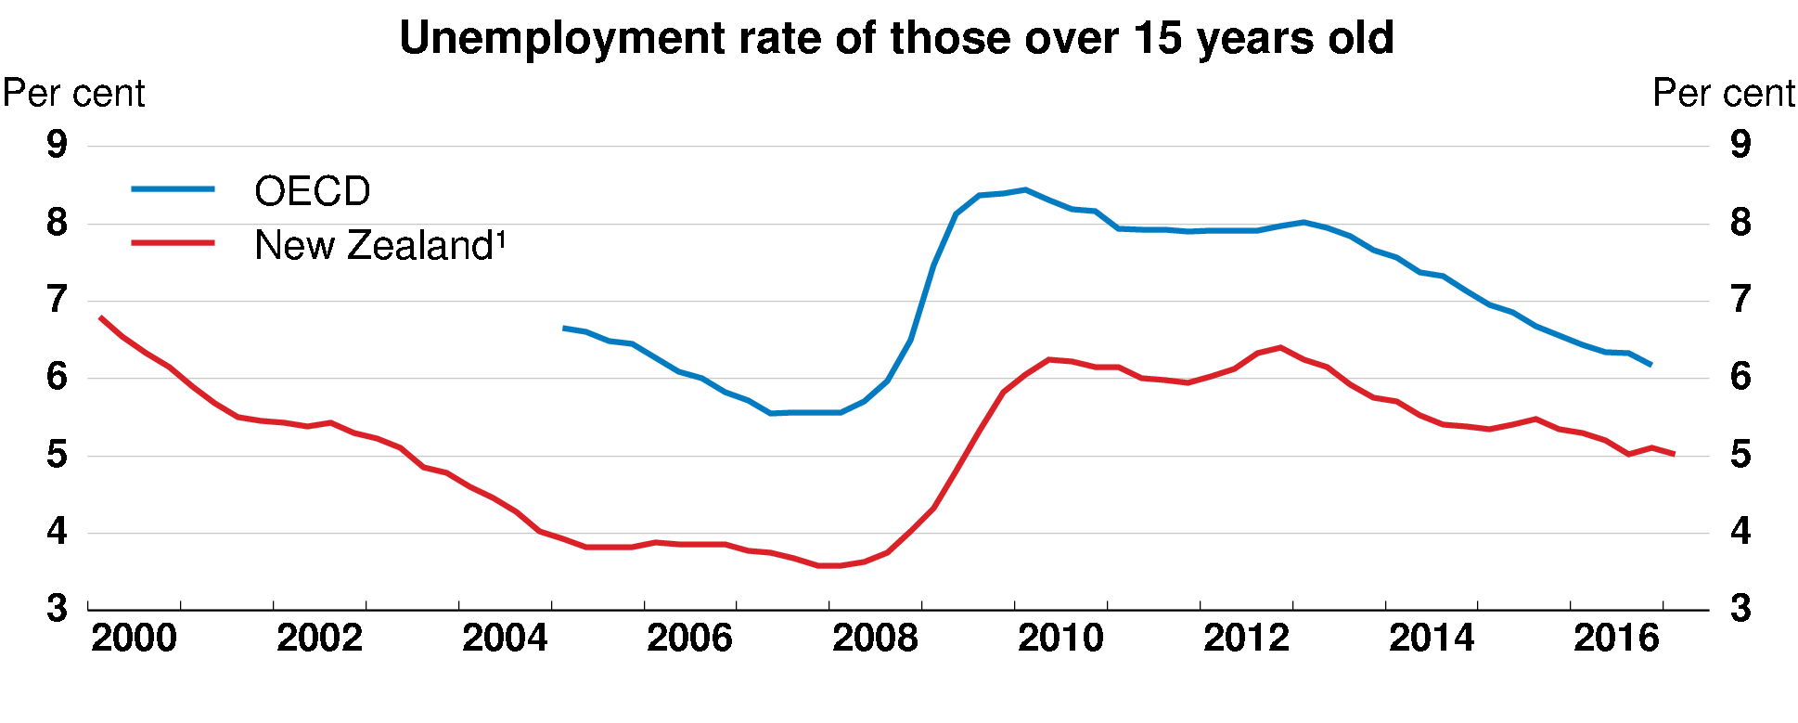
Unemployment is low
1. Four-quarter moving average series.
Source: OECD, Labour Force Statistics database.

Slide 5
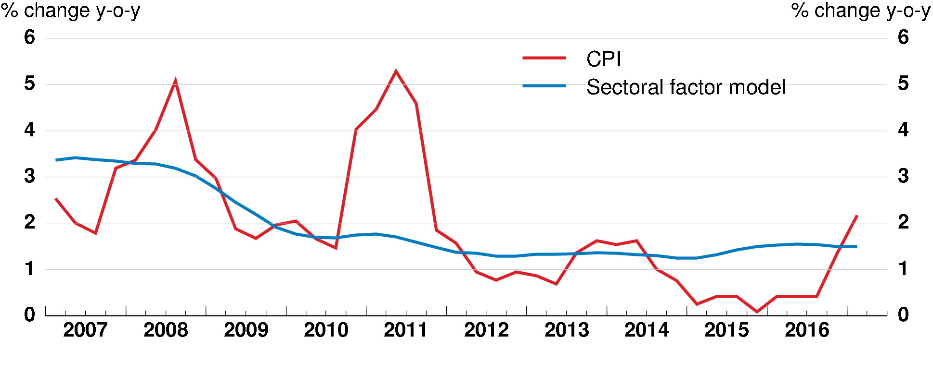
Inflation is low
Source: Reserve Bank of New Zealand.

Slide 6
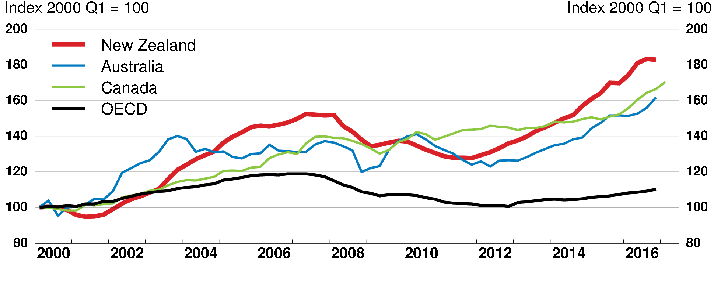
House prices are high relative to incomes
Source: OECD, Housing Prices database.

Slide 7
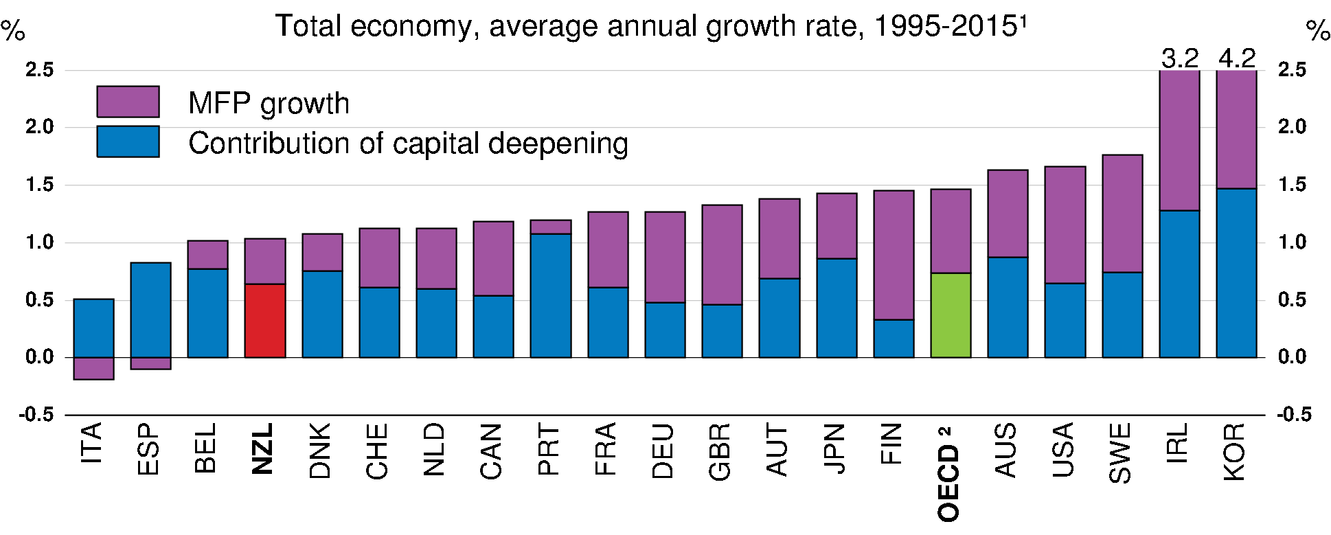
Labour productivity growth is low
1996-2015 for Austria; 1995-2014 for Australia, Ireland, Japan, Portugal and Spain.
Average of the 20 countries for which data are available.
Source: OECD (2017), Productivity database; OECD (2017), Economic Policy Reforms: Going for Growth 2017.

Slide 8
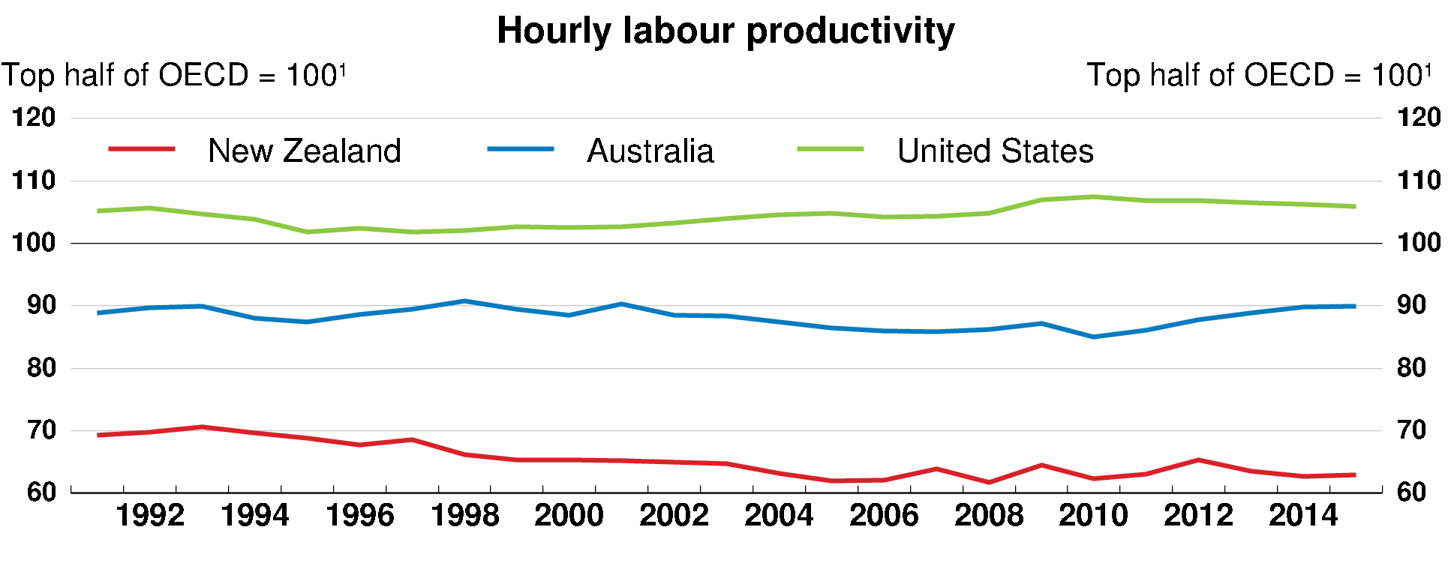
Labour productivity continues to lag
1. Population-weighted average for the top 17 OECD countries for labour productivity, calculated using 2010
purchasing power parity exchange rates.
Source: OECD (2017), Productivity database; OECD (2017), Economic Policy Reforms: Going for Growth 2017.

Slide 9
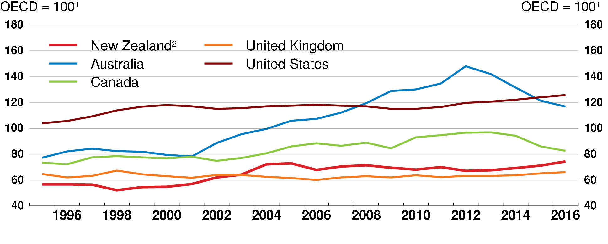
Non-residential investment per capita is low
Data for gross non-residential capital formation are in current prices and were converted into a common currency using
2010 purchasing power parity exchange rates. The labour force includes only people aged 15-64. Data for the OECD
exclude Chile, the Czech Republic, Estonia, Greece, Hungary, Iceland, Israel, Latvia, Luxembourg, Mexico, Norway,
the Slovak Republic, Slovenia and Turkey.
Excluding investment related to the Canterbury earthquake rebuild.
Source: OECD, Economic Outlook and Labour Force Statistics databases; A. Wood et al. (2016), 'The Canterbury
Rebuild Five Years on from the Christchurch Earthquake', RBNZ Bulletin, Vol. 79, No. 3, February.

Slide 10
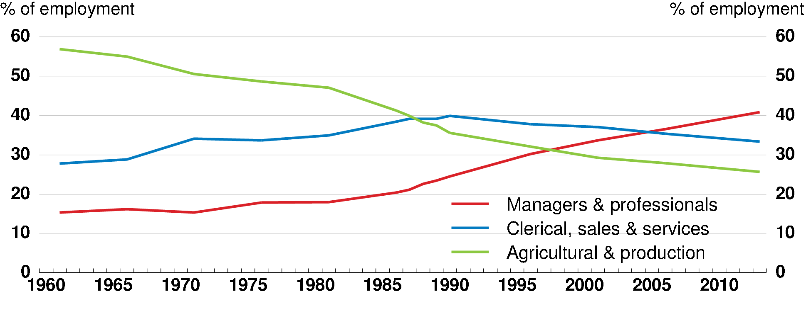
NZ employment is shifting to high-skilled occupations
Source: M. Handel (2012), Trends in Job Skill Demands in OECD Countries, OECD Social, Employment and Migration
Working Papers, No. 143; Statistics New Zealand, 2013 Census QuickStats about work and unpaid activities, Table 11.

Slide 11
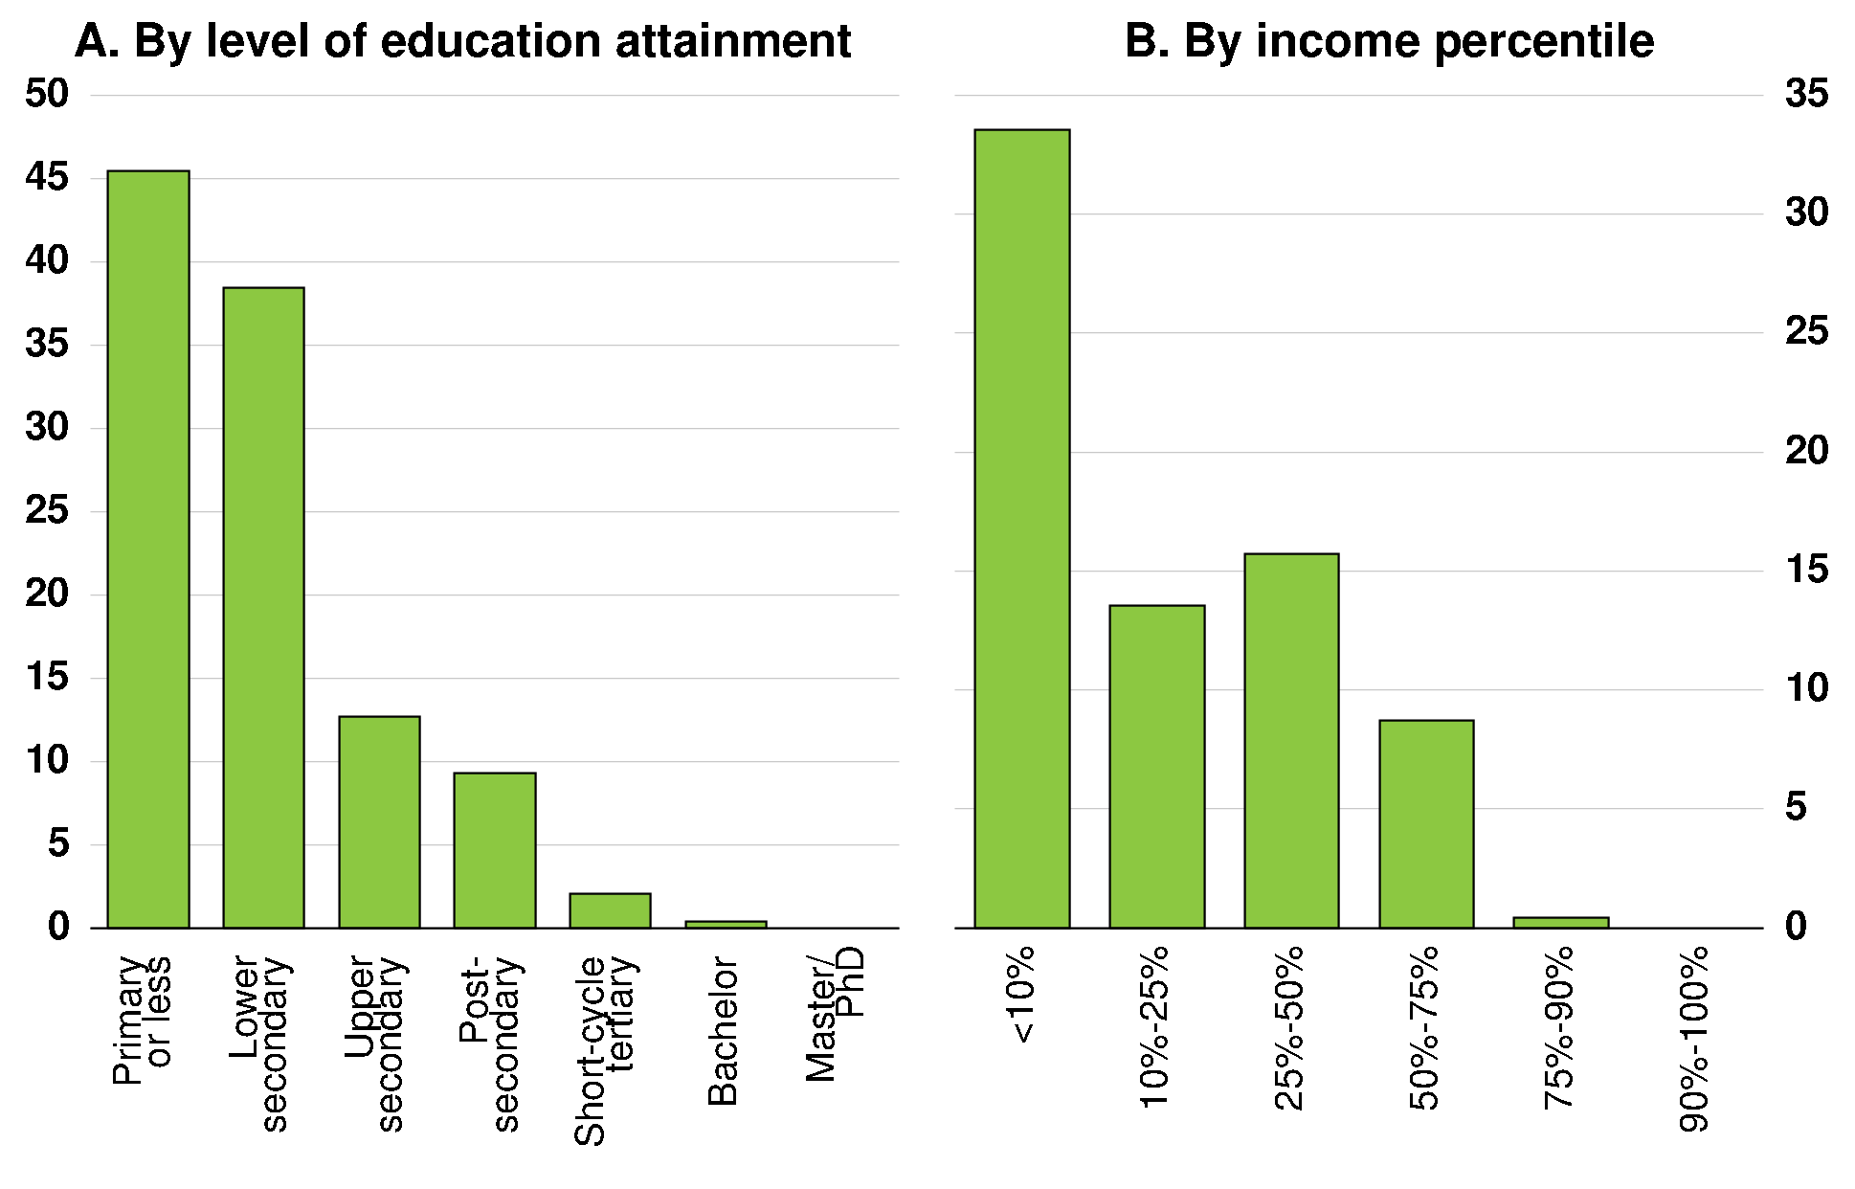
Automation potential in New Zealand is greatest for low-skilled workers
Share of workers in jobs at high risk of automation,¹ 2015
1. Workers are at high risk of automation if at least 70% of their tasks are automatable.
Source: OECD calculations based on the Survey of Adult Skills (PIAAC) (2015); M. Arntz et al. (2016), 'The Risk of
Automation for Jobs in OECD Countries: A Comparative Analysis', OECD Social, Employment and Migration Working
Papers, No. 189, http://dx.doi.org/10.1787/5jlz9h56dvq7-en.

Slide 12
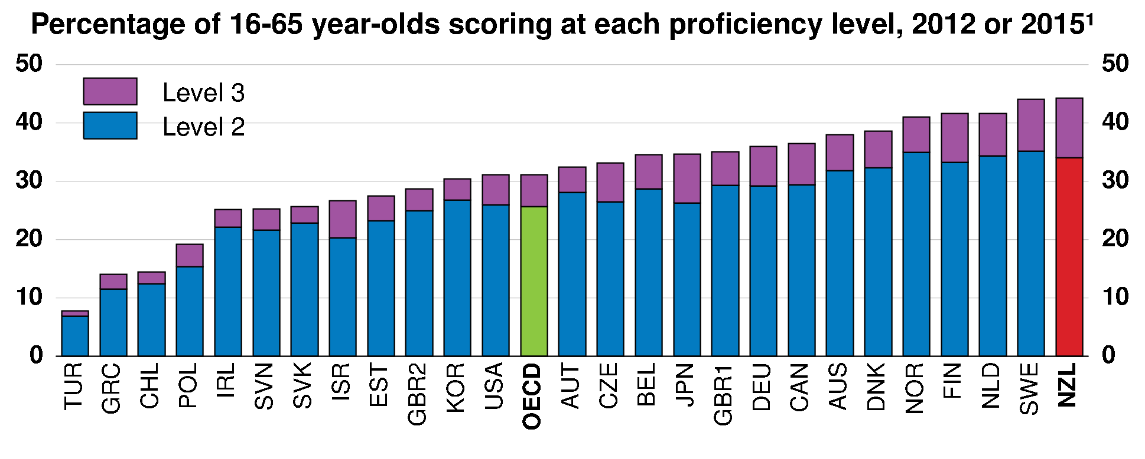
New Zealanders have high problem-solving skills in technology-rich environments
1. For the exact year of reference of the data, see footnote 2 in Figure 24. Data indicated as Belgium correspond to
Flanders; GBR1 = England and GBR2 = Northern Ireland.
Source: OECD (2016), Skills Matter: Further Results from the Survey of Adult Skills, Table A2.6; OECD Survey of Adult
Skills (PIAAC) database (2012 and 2015).

Slide 13
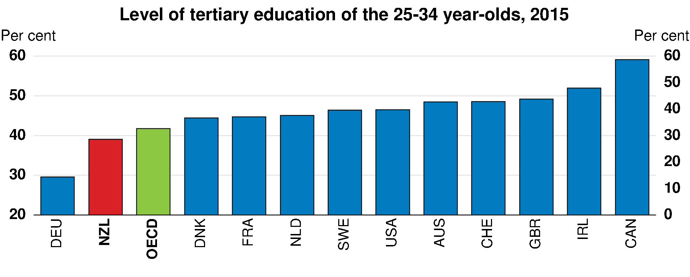
Tertiary education attainment is below the OECD average
Source: OECD (2016), Education at a Glance 2016: OECD Indicators, Table A1.3.

Slide 14
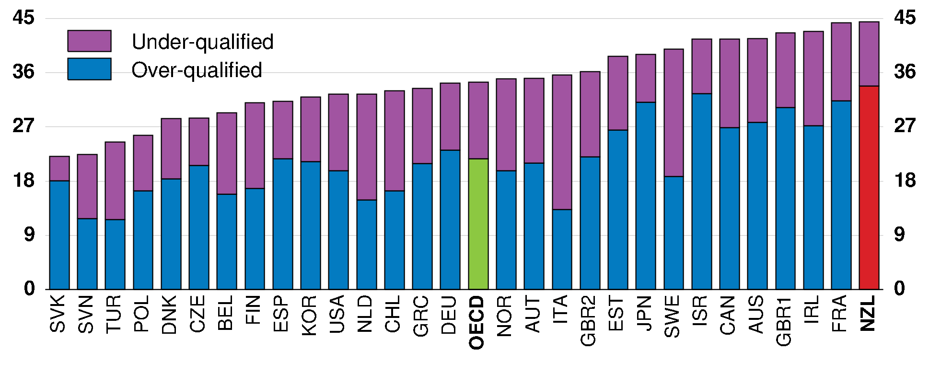
Many NZ workers are overqualified for their jobs
Percentage of mismatched workers,¹ by type of mismatch, 2012 and 2015²
Qualifications mismatch occurs when a worker has a higher or lower level of qualification than is required for his/her job.
Field-of-study mismatch occurs when a worker has a qualification in a different field than required for his/her job.
For the exact year of reference of the data, see footnote 2 in Figure 24. Data indicated as Belgium correspond to
Flanders; GBR1 = England and GBR2 = Northern Ireland.
Source: OECD (2016), Skills Matter: Further Results from the Survey of Adult Skills, Figure 5.7; OECD Survey of
Adult Skills (PIAAC) database (2012 and 2015).

Slide 15
Making growth more sustainable and greener

Slide 16
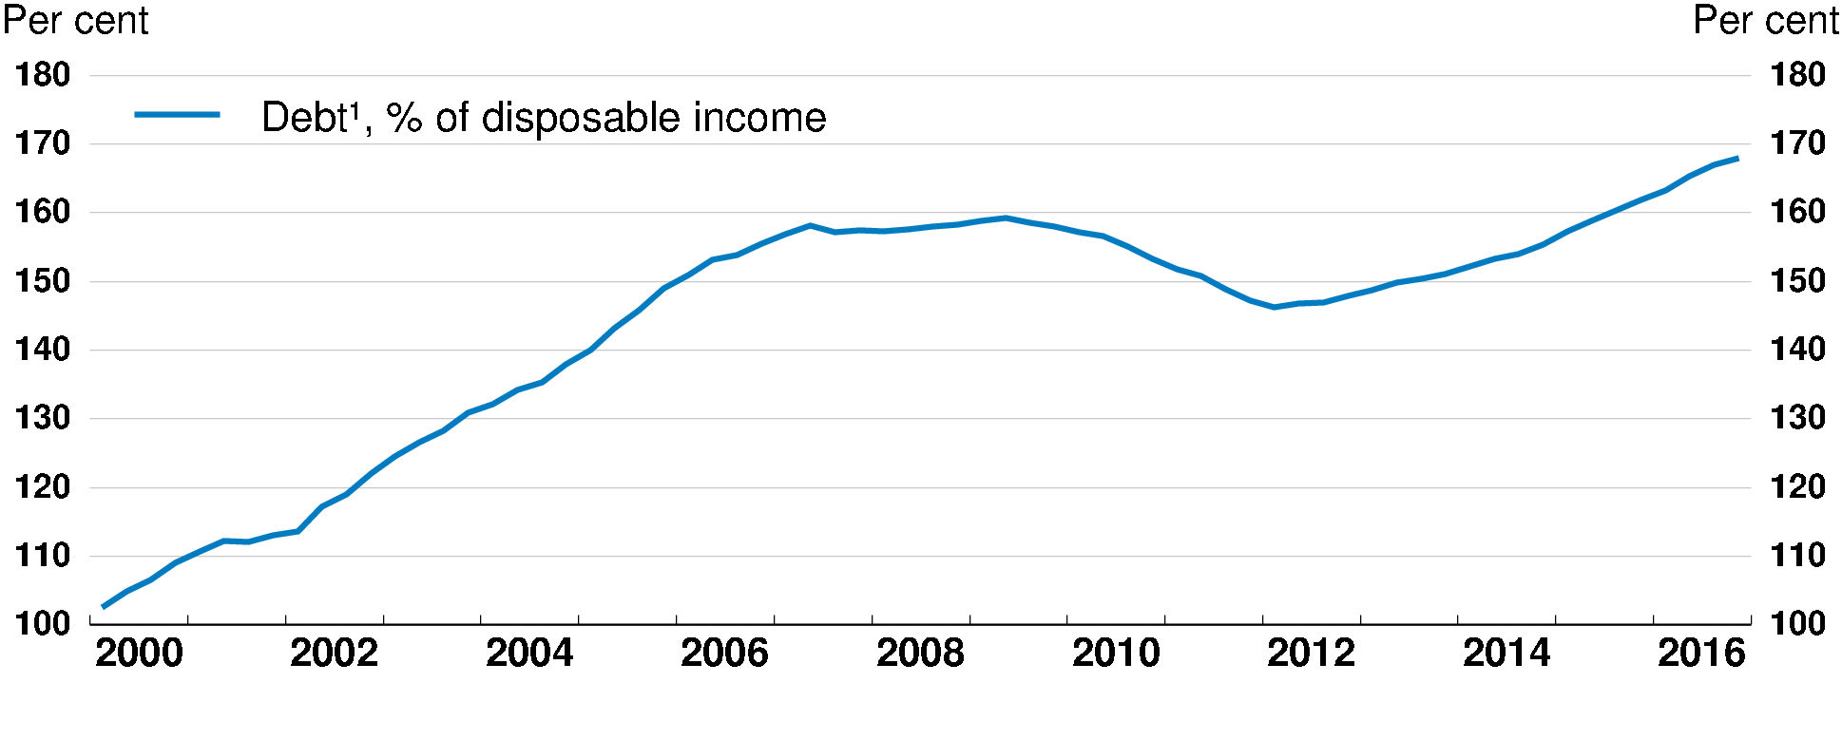
Household indebtedness is high
Including debt on rental properties.
Source: Reserve Bank of New Zealand, Statistics on Households.
Add a debt-to-income limit to the Reserve Bank’s macro-prudential toolkit, so long as benefits exceed costs.

Slide 17
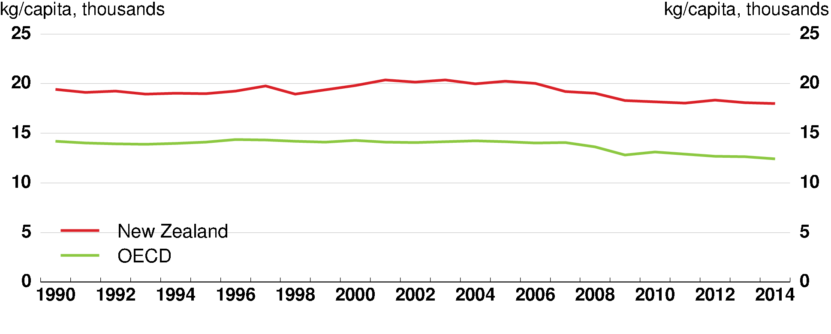
GHG emissions per capita are high
Source: OECD (2017), OECD Environment Statistics database.
Increase the price of carbon to a level consistent with New Zealand’s intended transition to a low carbon economy.
Adopt alternative pricing or regulatory measures to reduce regulatory emissions.
Support research in new mitigation technologies, especially for farming.

Slide 18
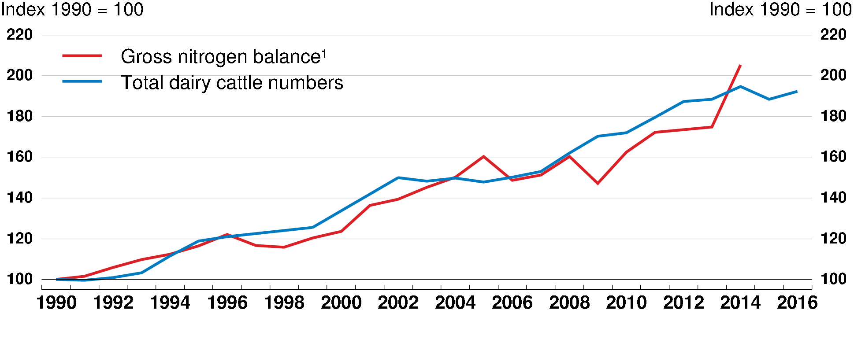
Pollution from dairy farming is reducing water quality
1. Kg of nitrogen per hectare of total agricultural land. The gross nitrogen balance calculates the difference between the nitrogen inputs entering a farming system (i.e. mainly livestock manure and fertilisers) and the nitrogen outputs leaving the system (i.e. the uptake of nitrogen for crop and pasture production).
Source: OECD/Eurostat Agri-Environmental Indicators Database; OECD Aglink database, www.agri-outlook.org; Statistics New Zealand; UK-Milk Development Council - LTO NEDERLAND.
Introduce pollution charges or cap-and-trade measures.
Expand water trading and pricing to ensure scarce water goes to its best use.

Slide 19
Other key recommendations to make growth more sustainable and greener
Gradually reduce net public debt in line with the government’s fiscal strategy. Increase spending that enhances well-being and reduces taxes within the constraints of this strategy.
Bring forward the planned increase in the age of eligibility for public pensions, lengthen the transition period, and then index the pension age to life expectancy.
Intensify the protection of threatened species by continuing to develop a National Policy Statement on biodiversity.
Notes:
This could be a candidate to drop so as to shorten.

Slide 20
Increasing productivity

Slide 21
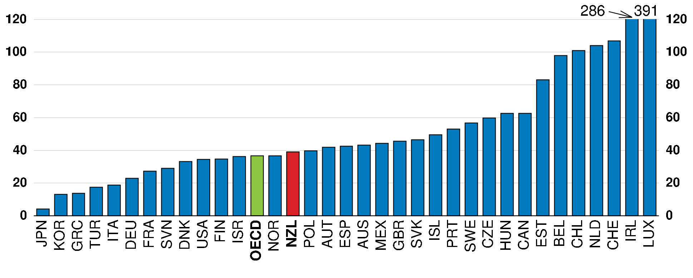
Inward FDI is low for a small country
As a percentage of GDP, 2016 or latest available data
Source: OECD, Foreign Direct Investment database.
Progressively narrow screening of foreign direct investment.
Continue to reduce compliance costs and boost predictability for investors.

Slide 22
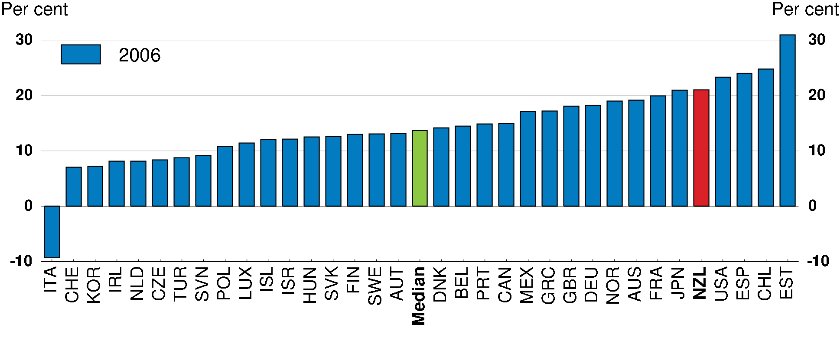
The effective marginal corporate tax rate is high
Source: Oxford University Centre for Business Taxation, CBT tax database.
Undertake a tax review that considers corporate and personal income tax settings and potential new tax bases.

Slide 23
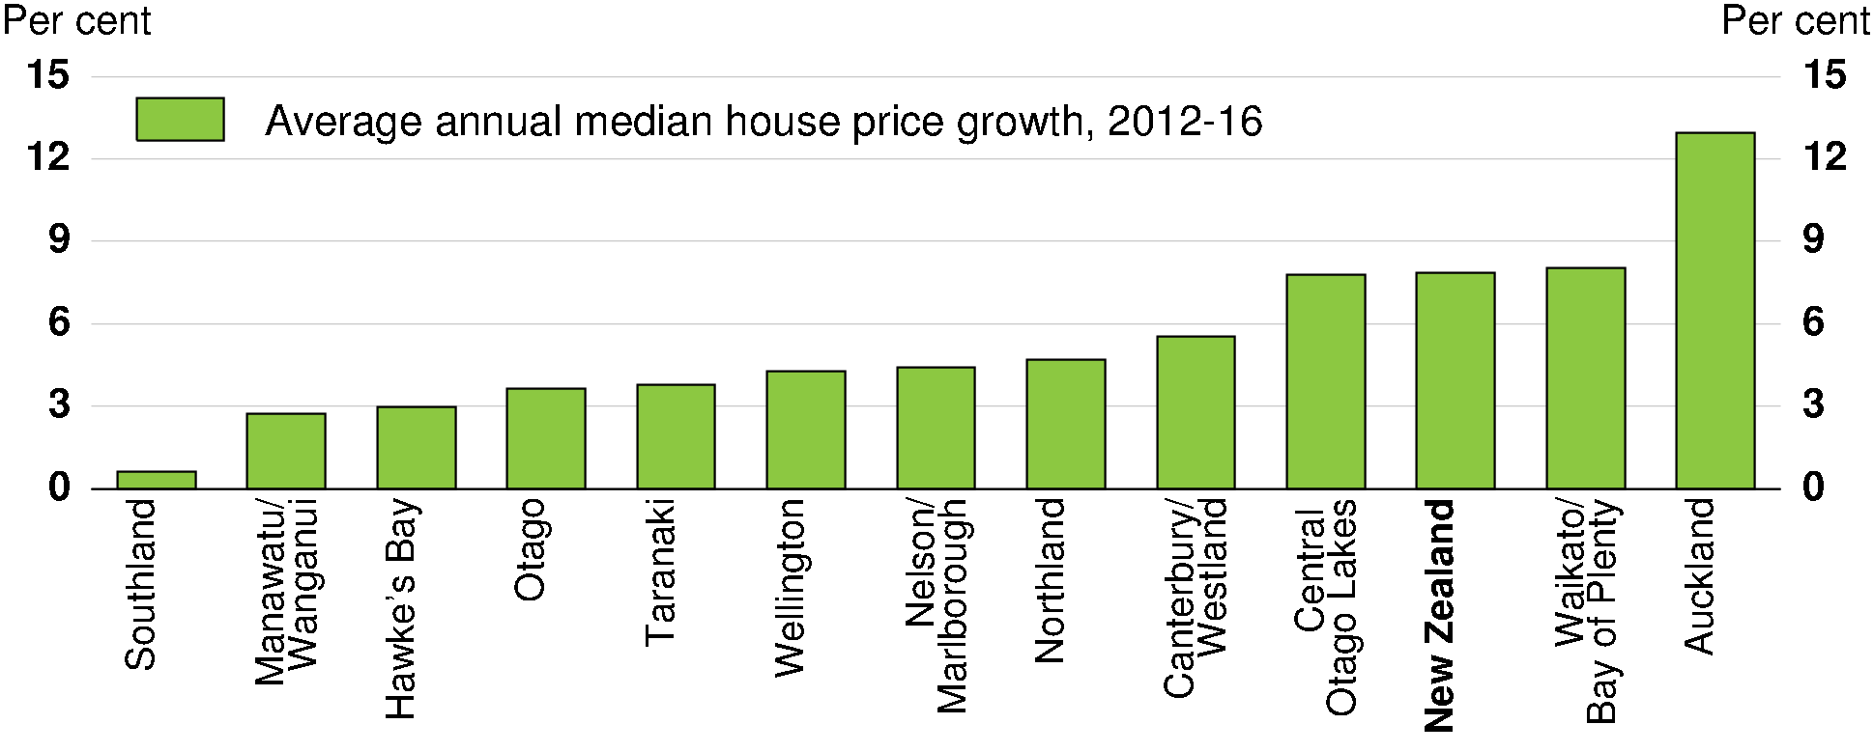
House prices have soared in Auckland, limiting agglomeration economies
Source: Real Estate Institute of New Zealand.
Enhance councils’ incentives to accommodate growth, for example by sharing a tax base linked to local economic activity.
Apply user charging more broadly for infrastructure, including congestion charging.

Slide 24
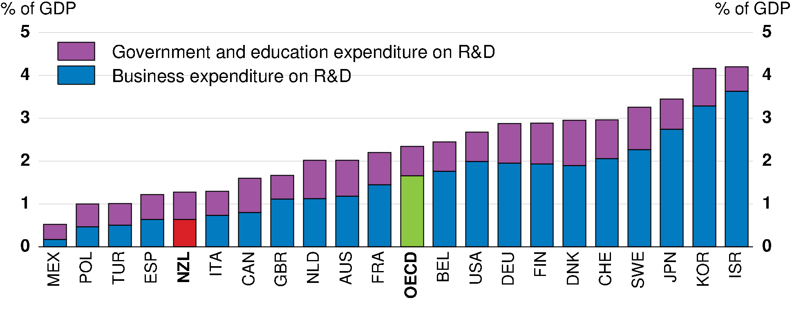
Expenditure on R&D is low
2015 or latest year available
Source: Statistics New Zealand; OECD, Main Science and Technology Indicators database, http://oe.cd/msti.
Increase fiscal support for business research and development.
Maintain or increase long-term support for successful collaboration between research institutions and industry.

Slide 25
Other key recommendations to increase productivity
To strengthen competition, consider refocusing competition law on the effects of potentially anti-competitive conduct, as opposed to its intent, and provide the Commerce Commission with the power and resources to undertake market studies.
Notes:
This could be a candidate to drop so as to shorten.

Slide 26
Adapting to the changing labour market

Slide 27
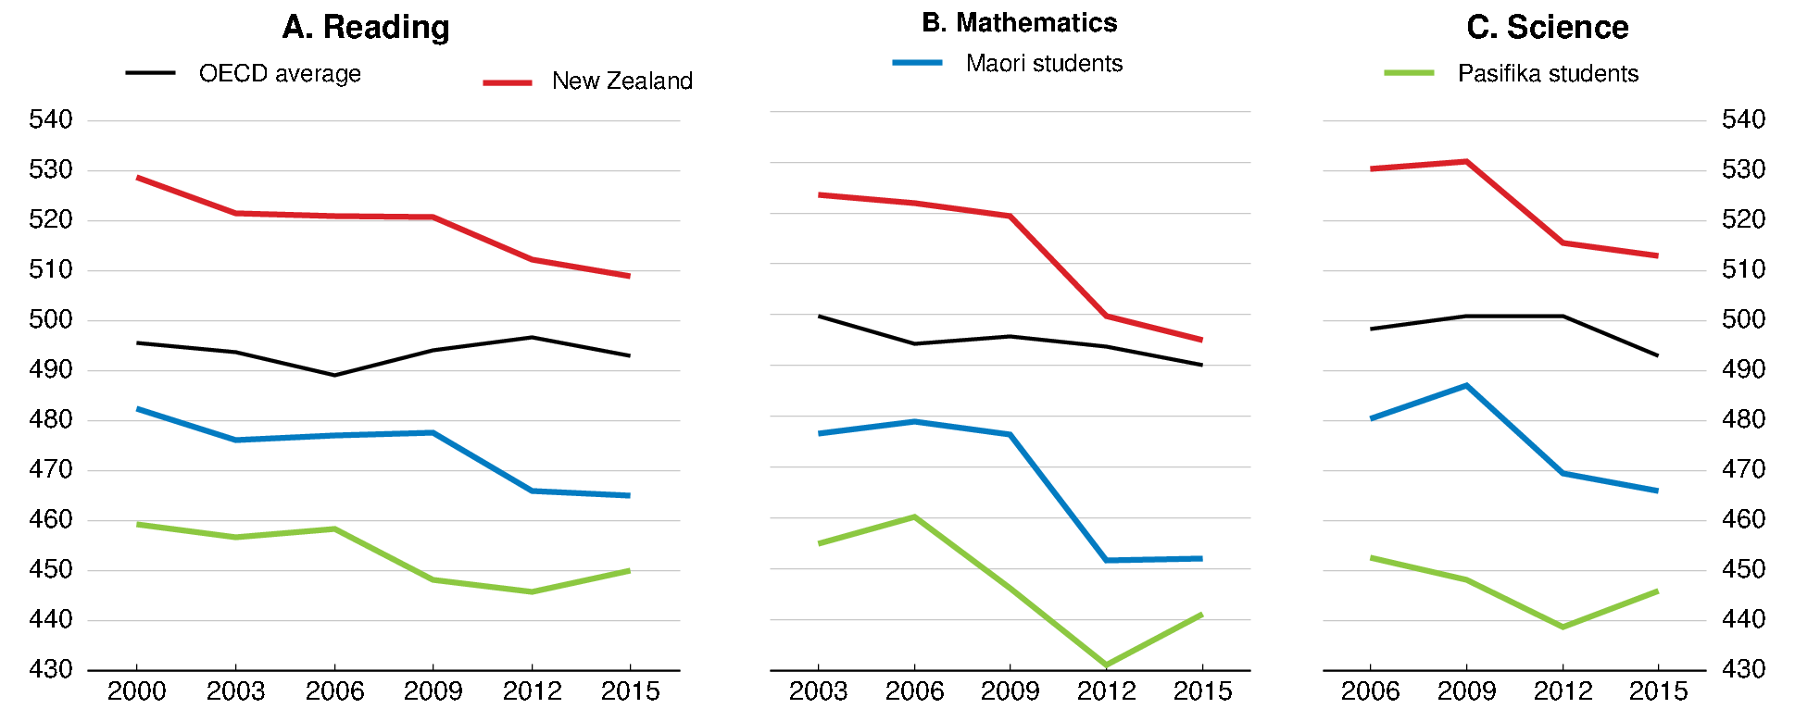
PISA scores have fallen, especially in mathematics
Source: OECD, PISA Results, various years; S. May, J. Flockton and S. Kirkham (2016), PISA 2015 - New Zealand Summary Report, Ministry of Education.
Improve mathematics teaching by supporting professional development and evidence-informed teaching and raising initial teacher education quality and entry standards.
Review minimum numeracy requirements for school qualifications and the minimum education required by all school leavers.
Help schools to make more effective use of ability grouping strategies.

Slide 28
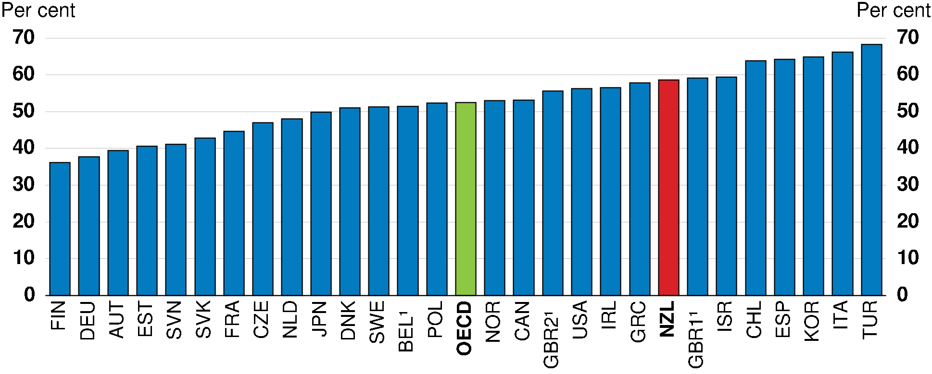
Most over-qualified workers are also field-of-study mismatched, 2012 and 2015¹
1. For the exact year of reference of the data, see footnote 2 in Figure 2.8. Data indicated as Belgium correspond to Flanders; GBR1 = England and GBR2 = Northern Ireland.
Source: OECD (2016), Skills Matter: Further Results from the Survey of Adult Skills, Figures 5.8a & 5.8b; OECD Survey of Adult Skills (PIAAC) database.
Merge Careers New Zealand into the Tertiary Education Commission to increase the extent to which young people choose study fields in demand and tertiary institutions adapt their programmes to employer requirements.

Slide 29
Many NZ workers are skill-mismatched for their jobs, reducing productivity
Source: M. Adalet McGowan and D. Andrews (2017), 'Skills Mismatch, Productivity and Policies in New Zealand:
Evidence from PIAAC', OECD Economics Department Working Papers (forthcoming); OECD calculations based
on the Survey of Adult Skills (PIAAC) (2012 and 2015).
Ease housing supply restrictions – inadequate infrastructure and urban planning laws - to improve the allocation of workers to jobs.

Slide 30
Greater support for displaced workers could reduce layoff costs they face
More workers are likely to be displaced in future as a result of technical change.
Stock of displaced workers is 1.1% of workforce, similar to other OECD countries, but re-employment rate after two years is high.
Most do not qualify for the means-tested unemployment benefit, half do not receive redundancy pay and few benefit from activation measures.
Displaced workers incur larger earnings losses when re-employed in New Zealand than in most other countries.
So:
Consider introducing unemployment insurance, or alternatively longer notice periods and mandatory notification of layoffs.
Consider expanding training, guidance and counselling for displaced workers.

Slide 31

More Information…
Disclaimers:
The statistical data for Israel are supplied by and under the responsibility of the relevant Israeli authorities. The use of such data by the OECD is without prejudice to the status of the Golan Heights, East Jerusalem and Israeli settlements in the West Bank under the terms of international law.
This document and any map included herein are without prejudice to the status of or sovereignty over any territory, to the delimitation of international frontiers and boundaries and to the name of any territory, city or area.
www.oecd.org/eco/surveys/economic-survey-new-zealand.htm
@OECDeconomy
@OECD

